Slide 1
User Guide for Windows Tools
http://2learner.edu.vn - http://2learner.hcmup.edu.vn
Hướng dẫn sử dụng công cụ/phần mềm

Slide 2
Contents
Instructional Softwares and Learning Tools
1
Advanced Power Point
2
Tools for Science and Maths
3
Tools for Technology
4
Tools for foreign language
5
Q&A

Slide 3
Cài đặt các ứng dụng, công cụ của Microsoft vào PC
Windows Live Essential 2012
Windows 8
Các công cụ của Office 2010

Slide 4
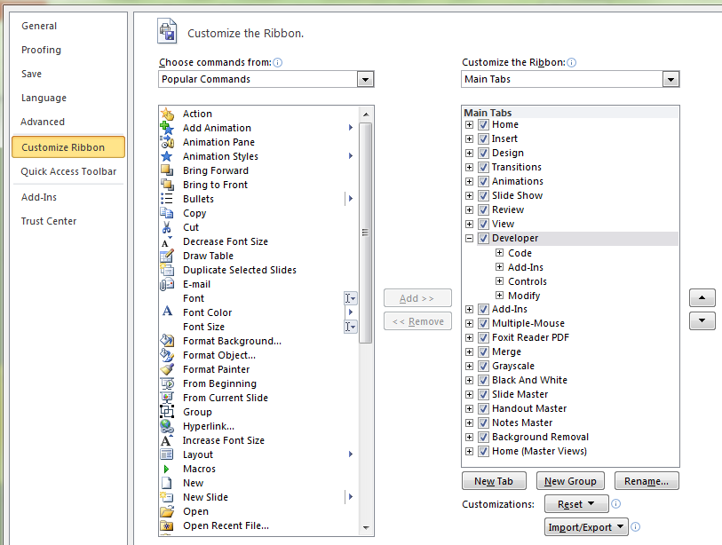
Power Point 2010 – phần nâng cao
Bật/tắt thanh công cụ Developer

Slide 5
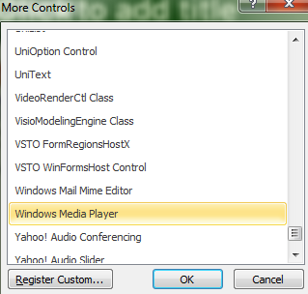
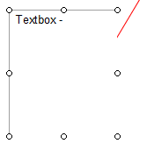
Sử dụng thanh công cụ Developer
Chèn vào một textbox –
cho phép gõ văn bản khi trình chiếu
Chèn vào các đối tượng khác …

Slide 6
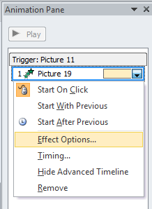
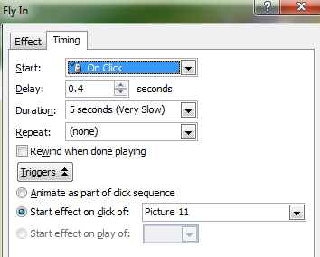
Kĩ thuật cò súng - Trigger
Picture 19
Picture 11
Hình con báo (chuyển động) – conbao.gif
Khi click vào hình thì xuất hiện một con báo khác di chuyển

Slide 7
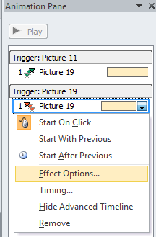
Kĩ thuật cò súng - Trigger
Picture 19
Picture 11
Hình con báo (chuyển động) – conbao.gif
Khi click vào hình thì xuất hiện một con báo khác di chuyển

Slide 8
Thực hành – game Trúc Xanh
1
9
Cho hai hình đang được đóng bởi 2 ô số 1, và số 9
Nhấp chuột để đóng hình.
Bấm vào bất kì ô 1, hoặc ô 9 – sẽ mở hình để xem
Bấm vào ô số còn lại – nhận thấy hình trùng lắp
Bấm vào hình Ovan để đóng cả hai hình đã chọn đúng

Slide 9
Trang hỗ trợ kĩ thuật
http://en.wikipedia.org/wiki/List_of_educational_software#Simulation
http://www.techlearning.com/Default.aspx?tabid=67&EntryId=4724
http://www.educatorstechnology.com/2012/08/a-list-of-great-educational-games-for.html

Slide 10
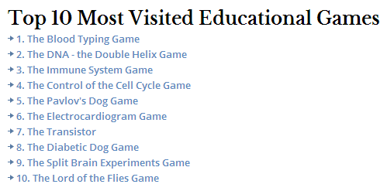
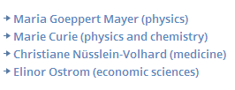
Trang hỗ trợ kĩ thuật
http://en.wikipedia.org/wiki/List_of_educational_video_games
The Best Collections Of Online Educational Games
http://larryferlazzo.edublogs.org/2009/05/21/the-best-collections-of-online-educational-games/
http://channel.nationalgeographic.com/
http://www.nobelprize.org/educational/

Slide 11
Trang hỗ trợ kĩ thuật
http://www.playkidsgames.com/

Slide 12
Trang hỗ trợ kĩ thuật
http://learnenglishkids.britishcouncil.org/en/learn-words
http://community.eflclassroom.com/page/games-for-language-learning
http://www.ranker.com/list/all-educational-games-list/reference

Slide 13
Yenka
http://www.yenka.com/
http://www.yenka.com/en/Downloads/

Slide 14
Thank You!
Lê Đức Long, longld@hcmup.edu.vn
www.2learner.edu.vn
03/2014

