Slide 1
TOOLS IN EDUCATION
Top tools for Learning and Teaching
Link

Slide 2
http://web2012.discoveryeducation.com/web20tools.cfm

Slide 3
http://www.edudemic.com/best-web-tools/

Slide 4
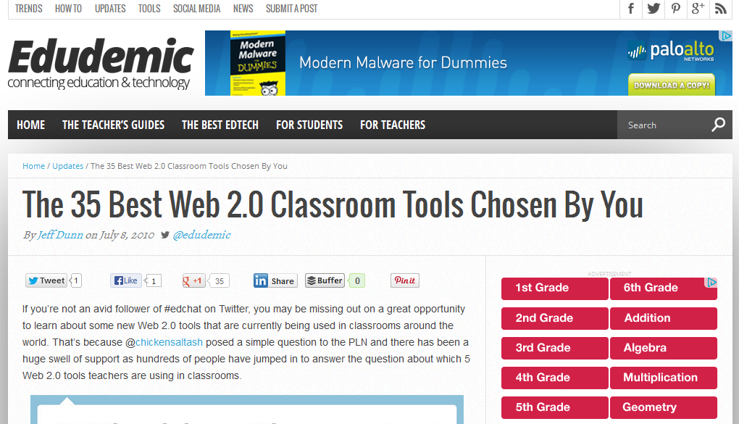
http://www.edudemic.com/the-35-best-web-2-0-classroom-tools-chosen-by-you/

Slide 5
http://c4lpt.co.uk/top100tools/

Slide 6
http://www.pcpro.co.uk/features/372979/10-free-online-tools-for-teaching-and-learning

Slide 7
http://top5onlinecolleges.org/teaching-tools/

Slide 8
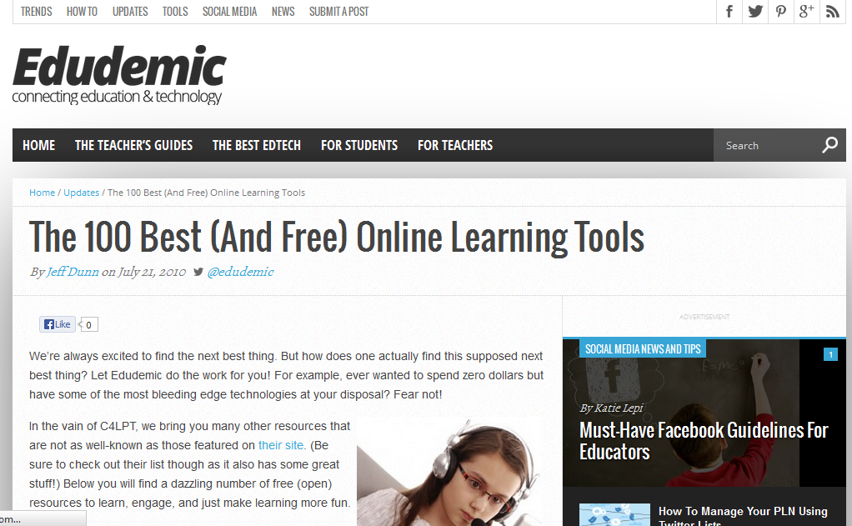
http://www.edudemic.com/the-100-best-and-free-online-learning-tools/

Slide 9
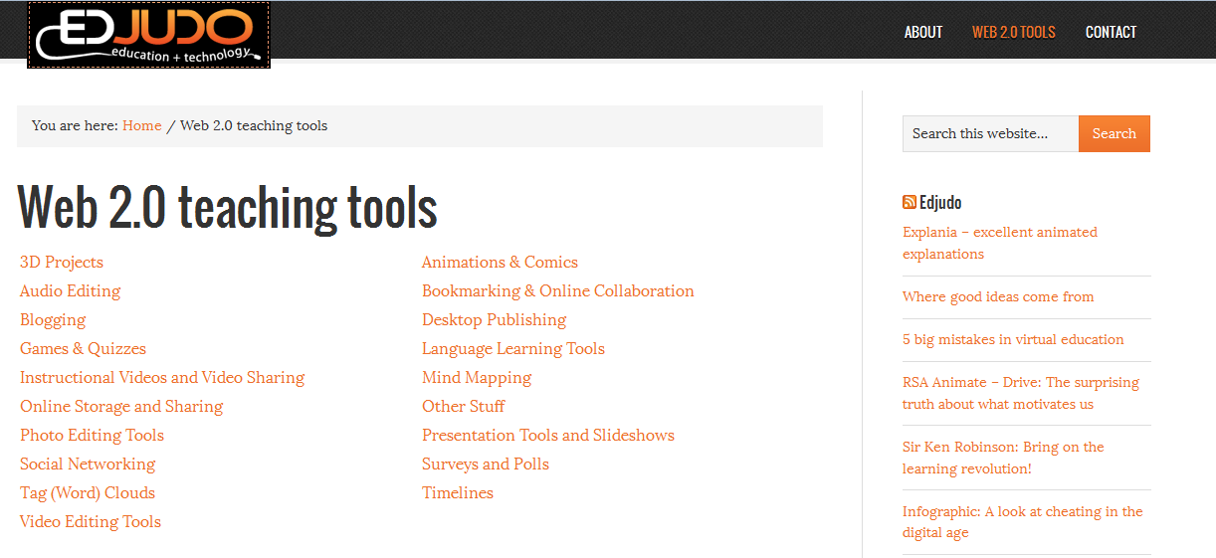
http://edjudo.com/web-2-0-teaching-tools-links

Slide 10
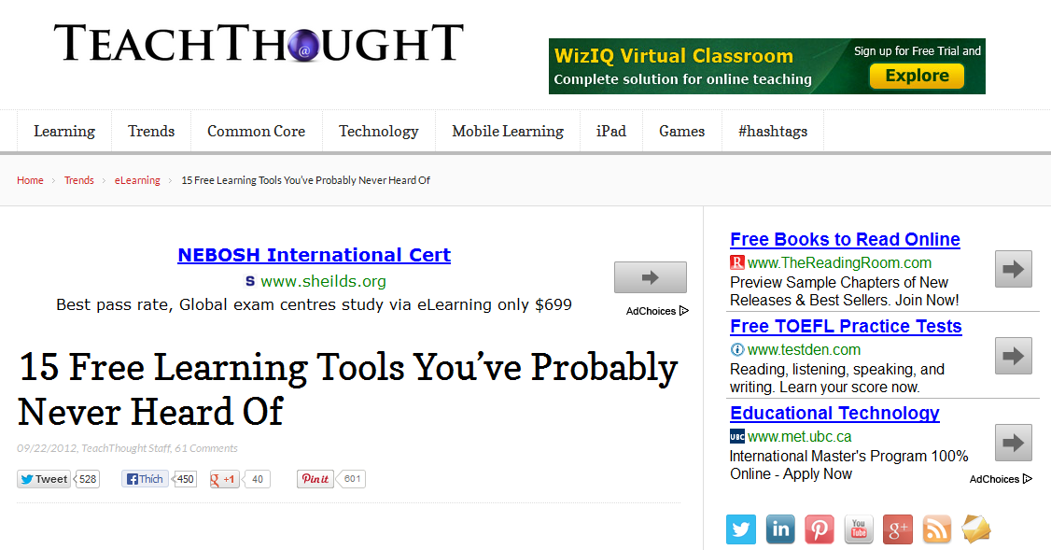
http://www.teachthought.com/trends/elearning/15-free-learning-tools-youve-probably-never-heard-of/

Slide 11
http://www.ala.org/aasl/standards-guidelines/best-websites/2013

Slide 12
Chọn một công cụ tùy ý …
Tìm hiểu và nghiên cứu
Cài đặt và sử dụngthử
Ứng dụng vào dạy-học
Kịchbản của bạn ???

