Slide 1
The Future of Learning: Web 2.0 and the Smart eXtended Web
Steve Wheeler
University of Plymouth, UK
LearnTEC, Karlsruhe, Germany: 2 February 2011

Slide 2
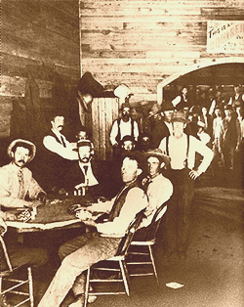
The Future...?
It is very difficult to predict the future. It’s difficult to even predict what will happen in the next year.
Steve Wheeler, University of Plymouth, 2011
www.abebooks.com

Slide 3
The Future...?
When he saw a demonstration of the telephone in 1880, a U.S Mayor declared: “One day every town in America will have a telephone!”
Steve Wheeler, University of Plymouth, 2011
www.abebooks.com

Slide 4
Here’s a problem for teachers:
“For the first time we are preparing students for a future we cannot clearly describe.”
- David Warlick
Steve Wheeler, University of Plymouth, 2011
http://communications.nottingham.ac.uk/podcasts/

Slide 5
Formal and Informal learning
Shouldn’t we now start to blend formal and informal learning?
Formal Learning
Informal Learning
80%
Steve Wheeler, University of Plymouth, 2011
20%
Source: Cofer, D. (2000). Informal Workplace Learning.

Slide 6
Is learning simply about gaining knowledge...?
Steve Wheeler, University of Plymouth, 2011
www.newmediamusings.com

Slide 7
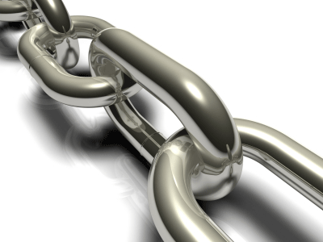
Steve Wheeler, University of Plymouth, 2011
... or about making connections?

Slide 8
Funnels and Webs
http://zumu.com
One size does not fit all
Steve Wheeler, University of Plymouth, 2011
Participation,
not passive reception of knowledge
Ivan Illich

Slide 9
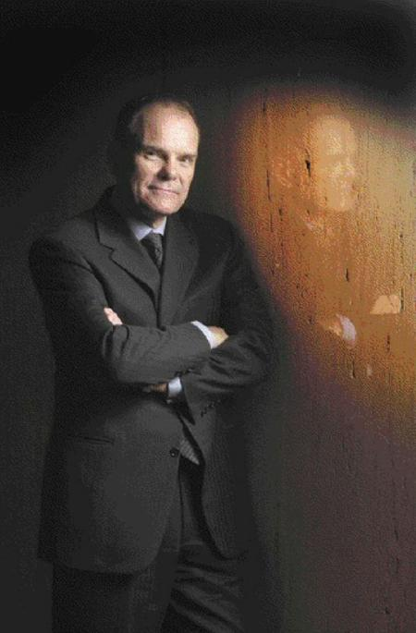
“It's not what you know that counts anymore. It's what you can learn.”
– Don Tapscott
Steve Wheeler, University of Plymouth, 2011
Connections to your community of practice
http://www.nationalpost.com

Slide 10
Digital Natives?
The Net Generation?
Steve Wheeler, University of Plymouth, 2011
http://socialenterpriseambassadors.org.uk
We shouldn’t be categorising learners like this!

Slide 11
Digital Natives?
Expectations
.....are not the same as...
Steve Wheeler, University of Plymouth, 2011
Net Generation?
Needs
http://socialenterpriseambassadors.org.uk

Slide 12
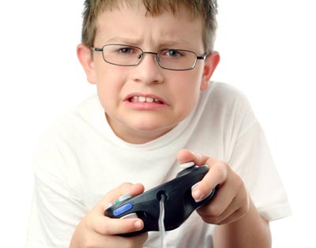
Learners enjoy learning when it’s engaging and fun!
Steve Wheeler, University of Plymouth, 2011

Slide 13
Engaging and fun!
Serious games
Interactive narratives
Steve Wheeler, University of Plymouth, 2011
Role play simulations
Massively Online Role Playing Games

Slide 14
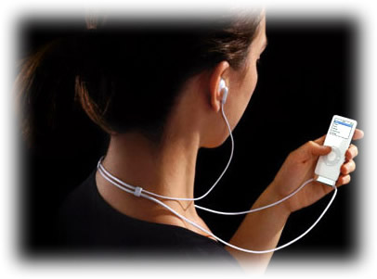
anytime
personalised
anyplace
Steve Wheeler, University of Plymouth, 2011
http://ithalas.com

Slide 15
Learners will need new ‘literacies’
Social networking
Privacy maintenance
Identity management
Creating content
Organising content
Reusing and repurposing
Filtering and selecting
Self broadcasting
Steve Wheeler, University of Plymouth, 2011
http://www.mopocket.com/

Slide 16
Learners will need new ‘literacies’
Social networking
Privacy maintenance
Identity management
Creating content
Organising content
Reusing and repurposing
Filtering and selecting
Self broadcasting
The new web environments are game changers. learners now need new (digital) literacies
Steve Wheeler, University of Plymouth, 2011
http://www.mopocket.com/

Slide 17
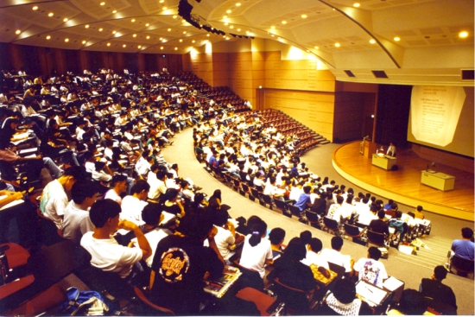
Steve Wheeler, University of Plymouth, 2011
http://www3.ntu.edu.sg
Personalised Learning?

Slide 18
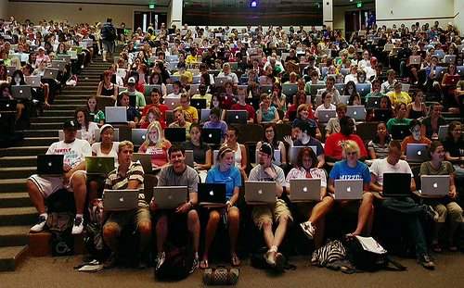
Steve Wheeler, University of Plymouth, 2011
http://www.flickr.com/photos/luc/
Personalised Learning?

Slide 19
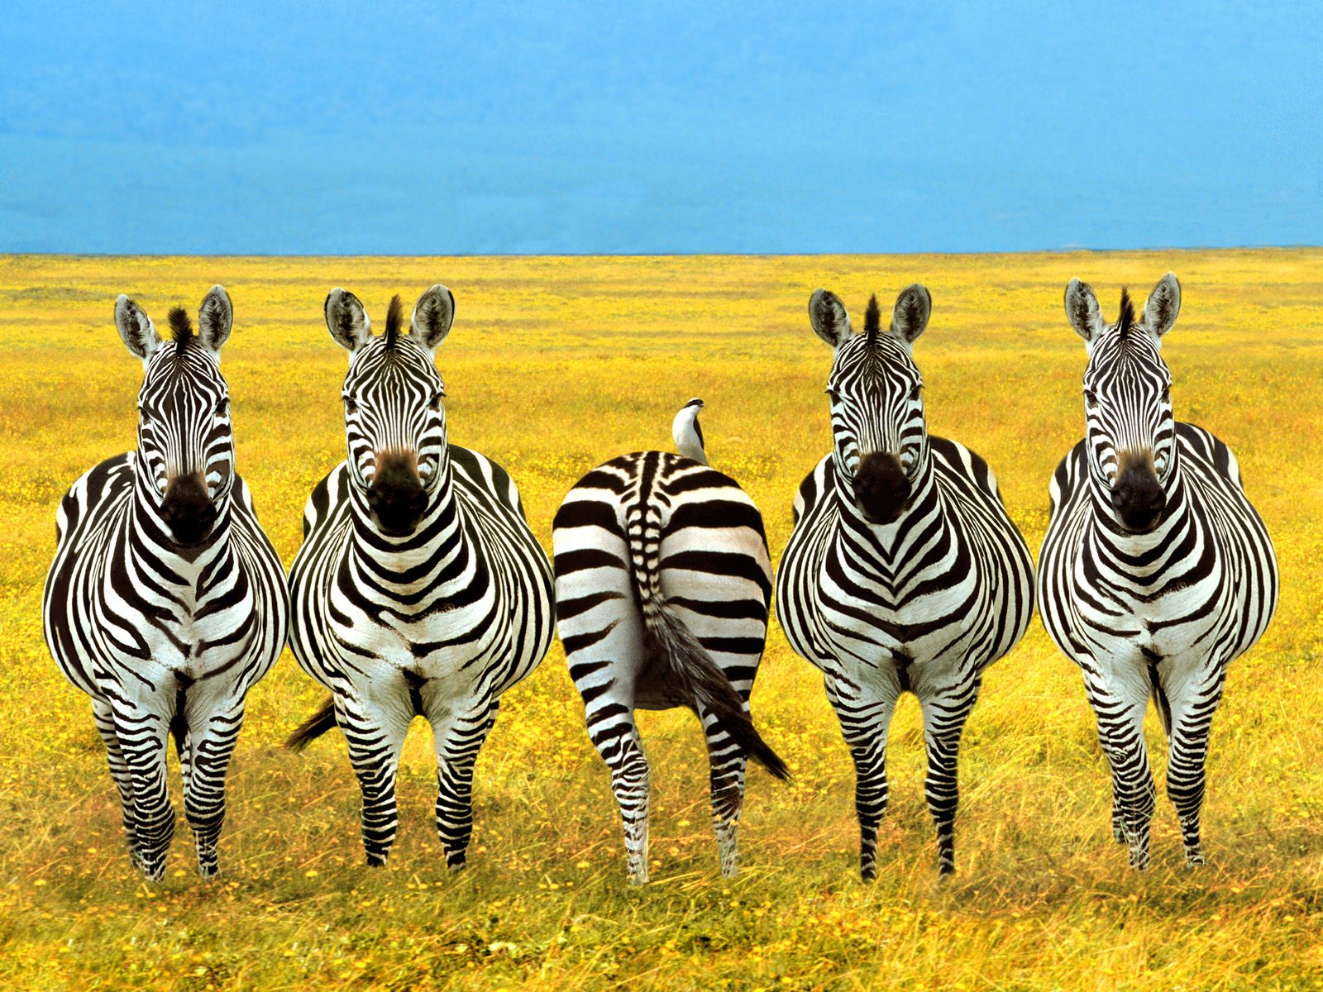
Personalisation of learning means ensuring that individual differences are acknowledged
Steve Wheeler, University of Plymouth, 2011

Slide 20
Personal Learning Environments
PLEs are not only personal web tools and personal learning networks. PLEs are much wider than this, taking in experiences and realia, as well as learning through TV, music, paper based materials, radio & more formal contexts.
Personal
Learning
Network
Personal
Learning
Environment
Steve Wheeler, University of Plymouth, 2011
Learning content is not as important now as where (or who) to connect to, to find it.
Personal
Web Tools
PWTs are any web tools, (usually Web 2.0) chosen by learners to support their lifelong learning.
Source: http://steve-wheeler.blogspot.com/2010/07/anatomy-of-ple.html

Slide 21
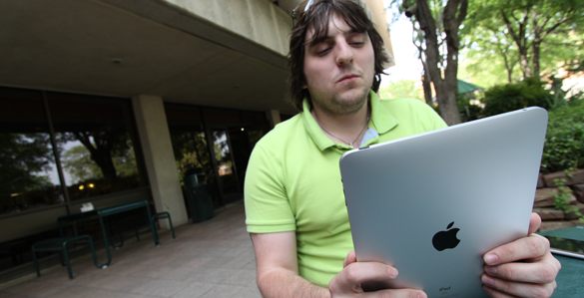
Intuitive handheld devices
Natural gesture interface
Steve Wheeler, University of Plymouth, 2011
Connection to my learning network
Source: Maria Webster - http://www.ntdaily.com/

Slide 22
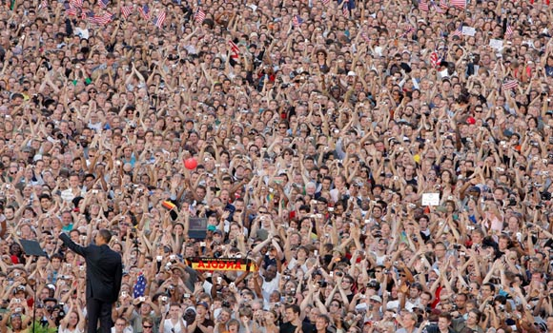
Connection
cc Steve Wheeler, University of Plymouth, 2010
Steve Wheeler, University of Plymouth, 2011
http://i.imwx.com

Slide 23
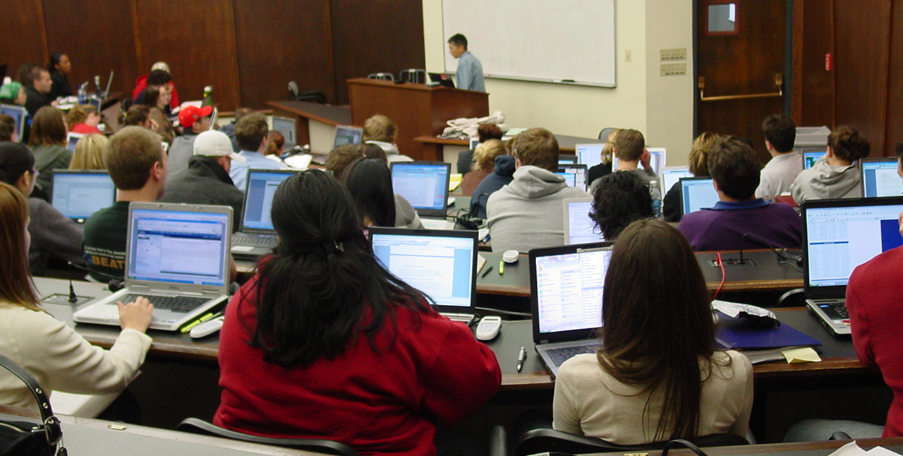
Communication
Steve Wheeler, University of Plymouth, 2011
Online, En masse
http://steve-wheeler.blogspot.com

Slide 24
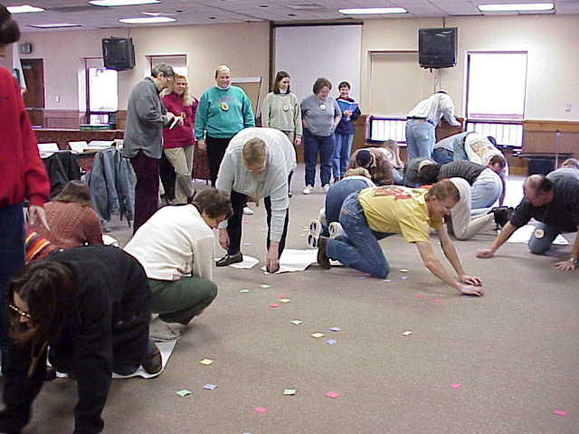
Collaboration
‘The wisdom of crowds’
Steve Wheeler, University of Plymouth, 2011
Common interests and purpose

Slide 25
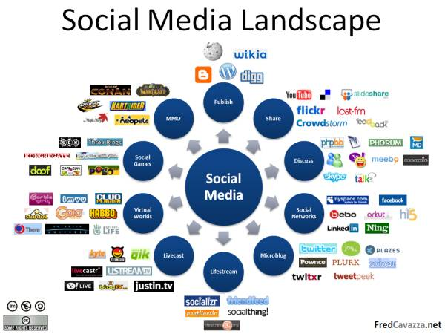
Web 2.0
From ‘sticky’ to participative
Steve Wheeler, University of Plymouth, 2011
The ‘Architecture of Participation’
http://www.eastone.co.uk/

Slide 26
Steve Wheeler, University of Plymouth, 2011
Social Media gives everyone a voice in the community
http://www.uksmallbusinesswebsites.co.uk

Slide 27
Social Media use
>125 Million
>500 Million
>100 Million
>50 Million
Steve Wheeler, University of Plymouth, 2011
>14 million
articles
2 Billion views/day
24 hours/minute
>4 Billion images
Source: http://econsultancy.com

Slide 28
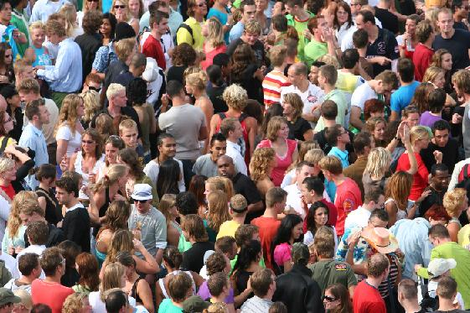
Architecture of Participation
Learning 2.0
Steve Wheeler, University of Plymouth, 2011
User generated content

Slide 29
Architecture of Participation
Sharing
Collaborating
Tools
Learning 2.0
Tagging
Steve Wheeler, University of Plymouth, 2011
User generated content
Voting
Networking

Slide 30
Blogging
In the act
of writing... ...we are written.
- Daniel Chandler
Steve Wheeler, University of Plymouth, 2011
http://www.volusion.com/

Slide 31
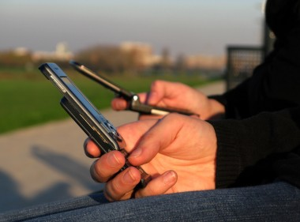
Moblogging
Blogging on the move to capture images, sounds, experiences
Steve Wheeler, University of Plymouth, 2011
http://www.lifehack.org

Slide 32
Microblogging
Retweeting is not repetition.
It is amplification.
- Steve Wheeler
http://www.xenstudio.co.uk

Slide 33
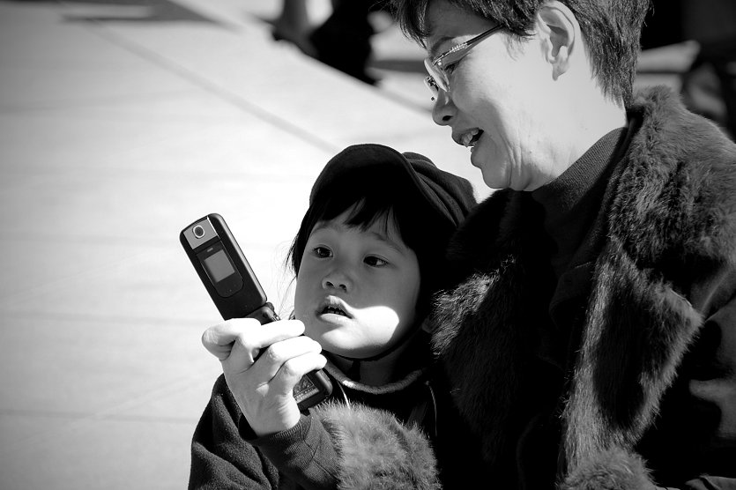
Microblogging has potential for the future of learning -
- if we see it as a new
communication
Channel
- Ebner et al
Steve Wheeler, University of Plymouth, 2011
http://www.flickr.com/photos/161/

Slide 34
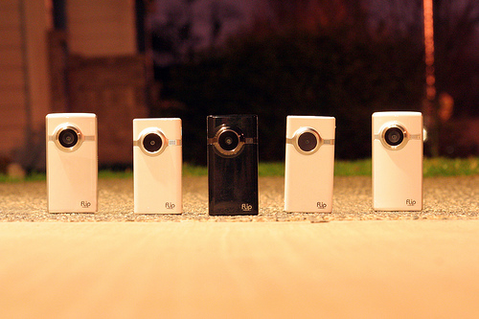
Media Sharing
Video, audio and images ...
Steve Wheeler, University of Plymouth, 2011
... all contribute to the richness of the narrative.
http://flickr.com/photos/22409393@N03/4348233990/

Slide 35
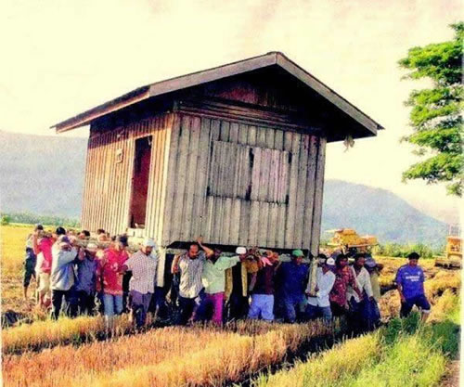
Collaborative tools
Steve Wheeler, University of Plymouth, 2011
http://media1.break.com/

Slide 36
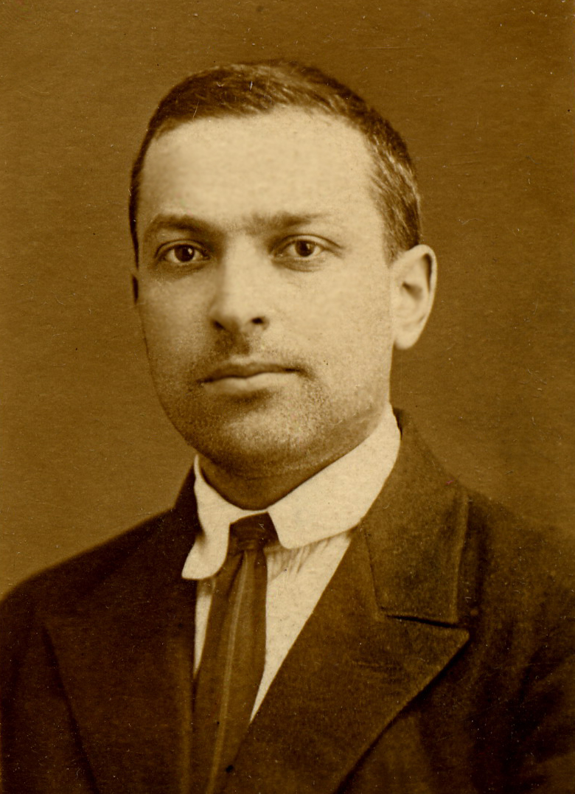
Social Learning
Human activities are mediated by culturally established instruments such as tools and language.
Vygotsky, L. S. (1978) Mind in Society: The development of higher psychological processes. Cambridge, MA: Harvard University Press
Steve Wheeler, University of Plymouth, 2011
http://www.phillwebb.net

Slide 37
Social Learning
We can use computers to extend the capabilities of our own minds. They can become the repositories of our knowledge.
Steve Wheeler, University of Plymouth, 2011
http://www.phillwebb.net
Computers as mind tools

Slide 38
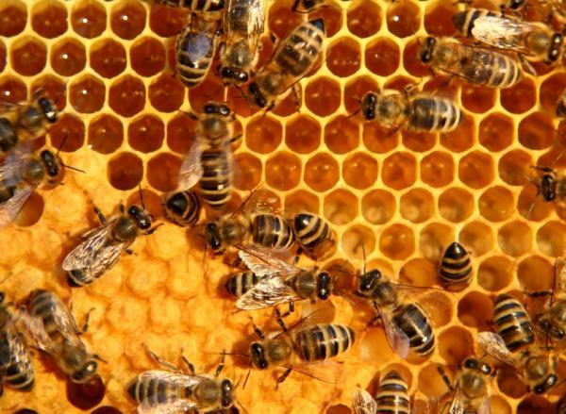
Connectivism
We live in a techno-social world
Learning occurs inside and outside of people – we store our knowledge in computers and in other people – George Siemens
Steve Wheeler, University of Plymouth, 2010
Source: George Siemens www.connectivism.ca/
http://www.sciencedaily.com

Slide 39
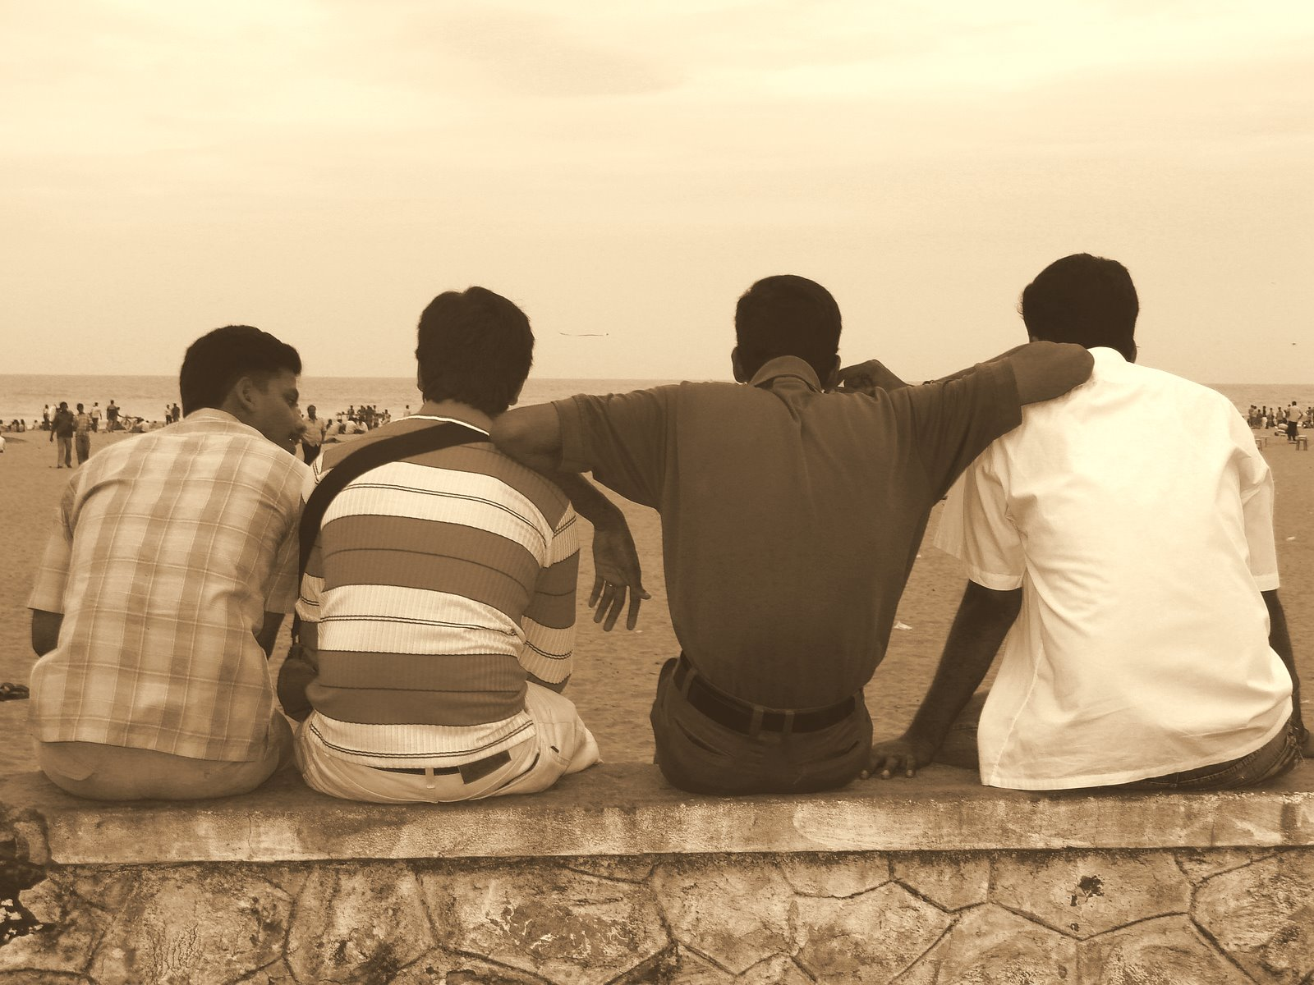
Since we cannot experience everything, other people’s experiences, and hence other people, become the surrogate for knowledge.
Steve Wheeler, University of Plymouth, 2010
‘I store my knowledge in my friends’ is an axiom for collecting knowledge through collecting people. - Karen Stephenson
http://bradley.chattablogs.com

Slide 40
Learning to learn
Critical thinking
Collaboration
Creativity
Reflection
Evaluation
http://socialenterpriseambassadors.org.uk
Steve Wheeler, University of Plymouth, 2011

Slide 41
Web 1.0: Anything can link to anything
Steve Wheeler, University of Plymouth, 2011
Source: Sabin-Corneliu Buraga
www.localseoguide.com

Slide 42
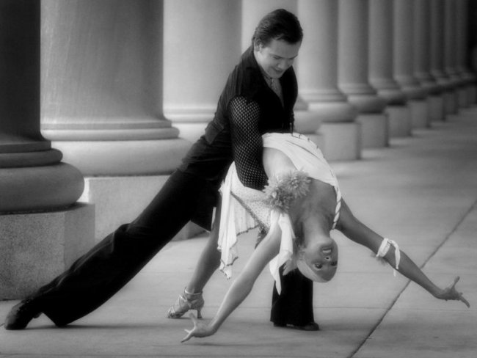
Web 2.0: User participation
Steve Wheeler, University of Plymouth, 2011
Source: Sabin-Corneliu Buraga
www.ballroom-dance-chicago.blogspot.com/

Slide 43
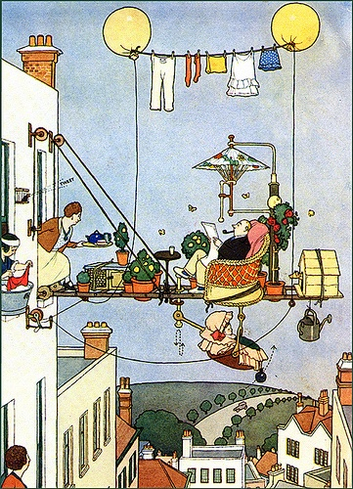
Web 3.0:
Existing data
re-connected for other (smarter) uses
Steve Wheeler, University of Plymouth, 2011
Adapted from : Sabin-Corneliu Buraga
http://farm4.static.flickr.com

Slide 44
Web 3.0
Web x.0
Semantic Web
Meta Web
Steve Wheeler, University of Plymouth, 2011
Degree of Information Connectivity
Web 1.0
Web 2.0
The Web
Social Web
Degree of Social Connectivity

Slide 45
The eXtended Web
Web 3.0
Web x.0
Semantic Web
Meta Web
Connects knowledge
Connects intelligence
Steve Wheeler, University of Plymouth, 2011
Degree of Information Connectivity
Web 1.0
Web 2.0
The Web
Social Web
Connects information
Connects people
Degree of Social Connectivity

Slide 46
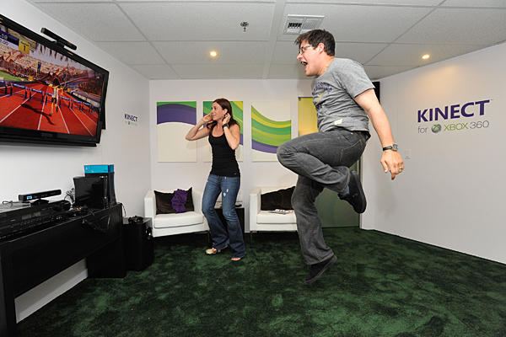
Steve Wheeler, University of Plymouth, 2011
http://www.csmonitor.com

Slide 47
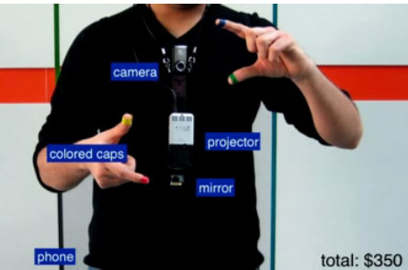
Coloured caps
Camera
Projector
Coloured caps
Steve Wheeler, University of Plymouth, 2011
Mirror
Phone
blogs.fayobserver.com
MIT’s “Sixth Sense” Wearable...

Slide 48
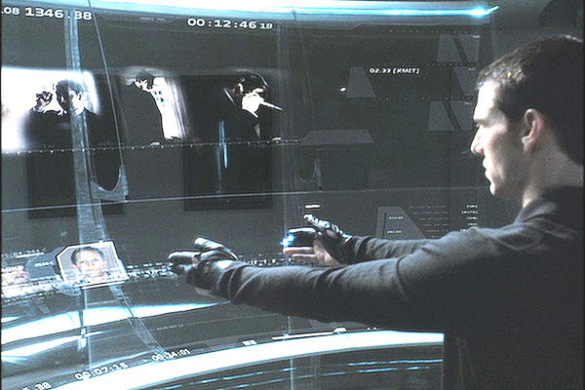
Natural user interfaces
Non touch systems
Gestural interaction
Steve Wheeler, University of Plymouth, 2011
Speech to text
Facial feature recognition
http://xenophilius.files.wordpress.com

Slide 49
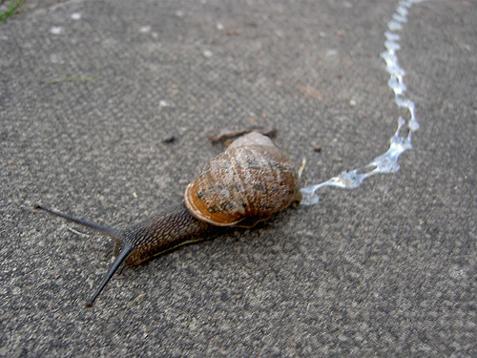
We are already seeing early evidence of the Smart eXtended Web
Steve Wheeler, University of Plymouth, 2011
Intelligent Filtering
Recommender systems
http://chemistscorner.com

Slide 50
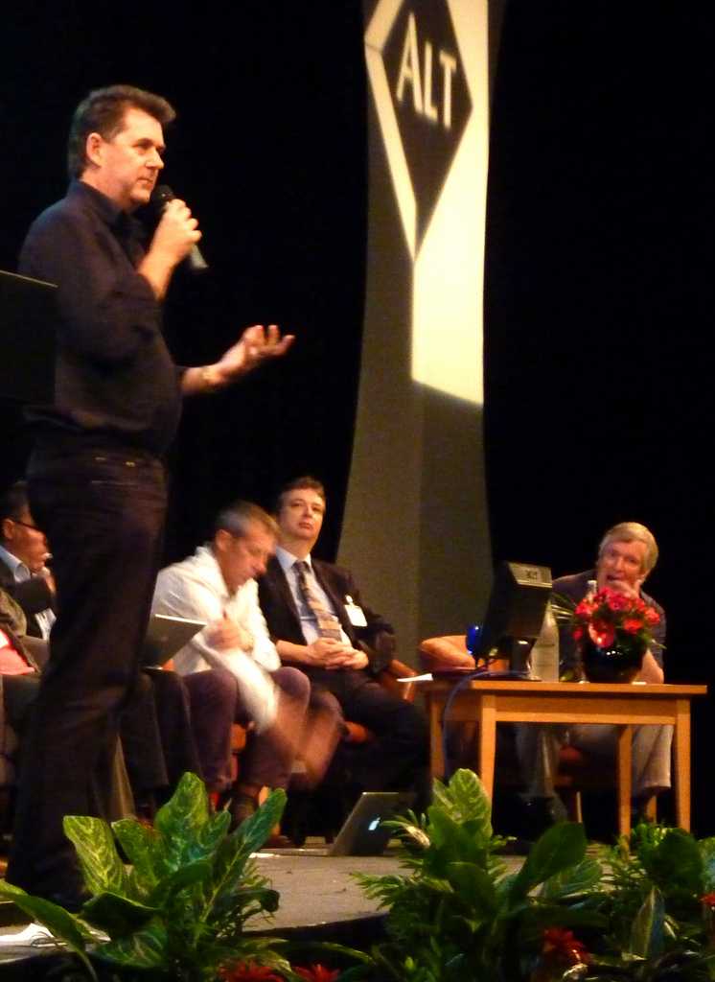
Thank you!
Steve Wheeler, University of Plymouth, 2011
W: steve-wheeler.net
E: swheeler@plymouth.ac.uk
B: steve-wheeler.blogspot.com
T: @timbuckteeth
Picture by Helen Keegan

