Slide 1


The e-learning skills gap
Clive Shepherd
www.skillsjourney.com

Slide 2

Surprising as it may seem, most educational and training methods are relatively timeless
exploration
observation
coaching
discovery
case studies
demonstration
consultation
simulation
instruction
discussion
briefings
assessment
performance support
networking
games
feedback
reading
lectures
questioning
collaboration
work experience
reflection
visits
research
projects
practice
role-play
sharing

Slide 3
Although at different times in history, we have tended to favour some methods over others
exploration
observation
coaching
discovery
case studies
demonstration
consultation
simulation
instruction
briefings
discussion
assessment
performance support
networking
games
feedback
reading
lectures
questioning
collaboration
work experience
reflection
visits
research
projects
practice
role-play
sharing

Slide 4
Right now, there are some good reasons to rethink the methods we use
New theories
New science
New expectations

Slide 5
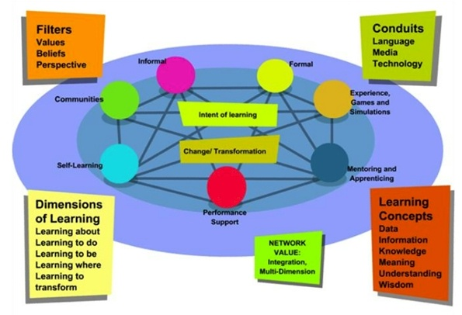
There are new theories like connectivism …
New theories
New science
New expectations
CONNECTIVISM

Slide 6

… which emphasises the importance of networks and networking to learning
New theories
New science
New expectations
“Instead of the individual having to evaluate and process every bit of information, she/he creates a personal network of trusted nodes: people and content, enhanced by technology. The act of knowledge is offloaded onto the network itself.”
George Siemens, Knowing Knowledge

Slide 7
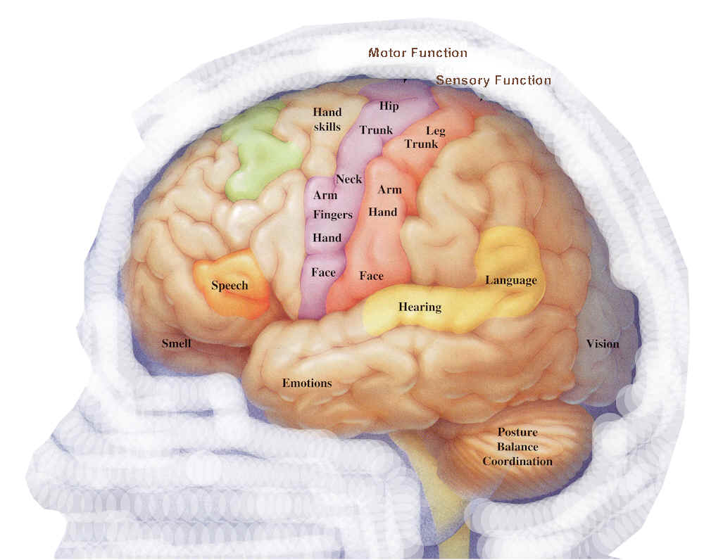
We’ve also seen major advances in what we know about the brain and how people learn
New theories
New science
New expectations
NEUROSCIENCE

Slide 8
We now have no excuses for overloading learners with indigestible information
New theories
New science
New expectations
NEUROSCIENCE

Slide 9
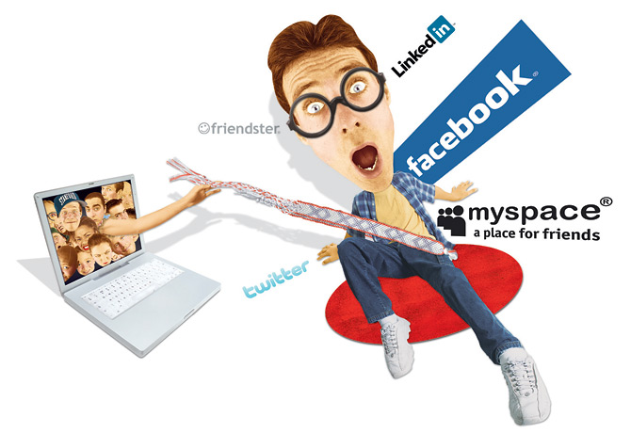
We also have to respond to the expectations of a new generation of learners
New theories
New science
New expectations
Gen Y: digital, social and always-on

Slide 10
There are two ways of looking at Generation Y
New theories
New science
New expectations
“Gen Y are tolerant, optimistic, collaborative,
open-minded and driven.”
suite101.com
“Gen Y are the 'diva' generation: high-maintenance, out for themselves, lacking in loyalty, thinking only of the short term
and their own place in it..”
Association of Graduate Recruiters

Slide 11
Although it could be that Gen Y are just more vocal in demanding what we’ve always wanted
New theories
New science
New expectations
How Gen Y want learning to be:
Interactive
Student-centred
Authentic
Collaborative
On-demand
don’t we all?
Barking Robot, 2006

Slide 12
New thinking, new science and new expectations demand a shift in emphasis
exploration
observation
coaching
discovery
case studies
demonstration
consultation
simulation
instruction
discussion
briefings
assessment
performance support
networking
games
feedback
reading
lectures
questioning
collaboration
work experience
reflection
visits
research
projects
practice
role-play
sharing

Slide 13
At the same time, we face great pressures
Time pressures
Budget pressures
Green pressures

Slide 14

We’re under increasing pressure to deliver learning solutions more quickly
Time pressures
Budget pressures
Green pressures
“72% of all training challenges are time-critical.”
Bersin & Associates (2005)
TIME PRESSURES

Slide 15
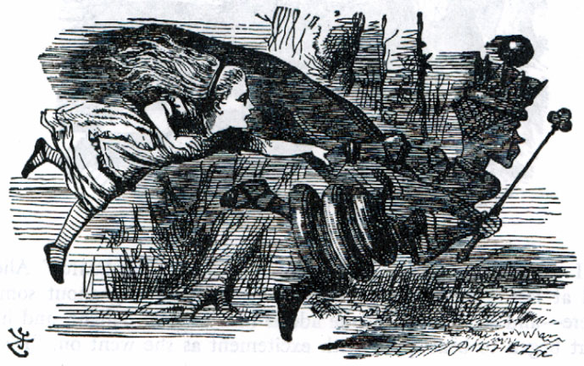
Sometimes it seems we are having to run ever faster just to stay in the same place
Time pressures
Budget pressures
Green pressures

Slide 16
We need to be able to respond differently to different situations
Time pressures
Budget pressures
Green pressures
A PYRAMID OF LEARNING INTERVENTIONS
Formal responses
Rapid responses
User-generated responses
TOP DOWN
Source: Nick Shackleton-Jones, BBC
BOTTOM-UP

Slide 17

Oh, and did I forget the financial pressures?
Time pressures
Budget pressures
Green pressures
COST PRESSURES

Slide 18
Times are certainly tougher in learning and development as budgets are slashed
Time pressures
Budget pressures
Green pressures
“Be aware that the
magnitude of the financial
meltdown is almost beyond
comprehension. I can foresee
training departments being eliminated almost entirely.”
Jay Cross (2008)

Slide 19

The need to think green may have taken a back seat right now, but we know we should be reducing travel where we can
Time pressures
Budget pressures
Green pressures
ENVIRONMENTAL PRESSURES

Slide 20
We can’t meet all these pressures just by changing methods
We choose methods to maximise the effectiveness of learning
We choose media to maximise the efficiency of learning
And the new pressures (time, environmental, budgetary) require, above all, greater efficiencies

Slide 21

Luckily, learning media are evolving rapidly. And new learning media enable change
books
tapes
workbooks
CDs
DVDs
podcasts/
vodcasts
web pages
downloadable documents
streaming media
instant messaging
email
chat rooms
forums
web conferencing
blogs
social networks
wikis
teleconferencing
SMS
telephone
simulators

Slide 22
Technology is providing some major new opportunities
New tools
New devices
New bandwidth

Slide 23

The latest web tools allow us to collaborate as never before, not just at home but at work
New tools
New devices
New bandwidth
WEB 2.0 TOOLS

Slide 24
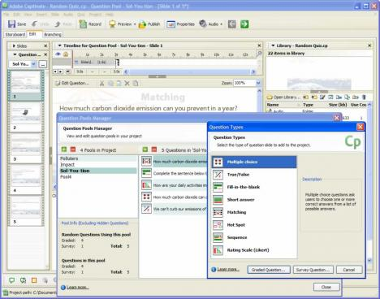
New, easy-to-use tools make it easier than ever to create self-paced learning content
New tools
New devices
New bandwidth
RAPID DEVELOPMENT TOOLS

Slide 25
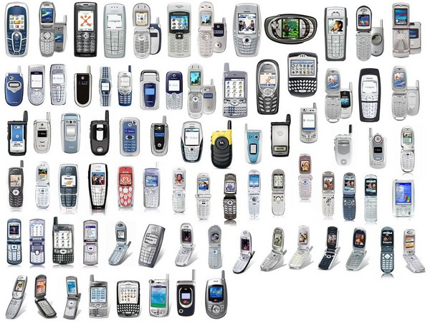
And the latest mobile devices provide connectivity for those who aren’t always sitting behind a desk
New tools
New devices
New bandwidth
MOBILE DEVICES

Slide 26

We’re getting near to the point when anyone who wants their own computer can afford one
New tools
New devices
New bandwidth
EVER MORE ACCESSIBLE COMPUTING

Slide 27
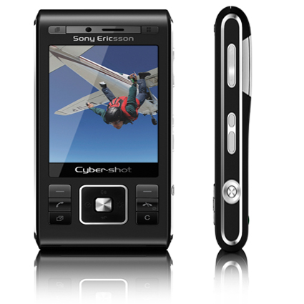

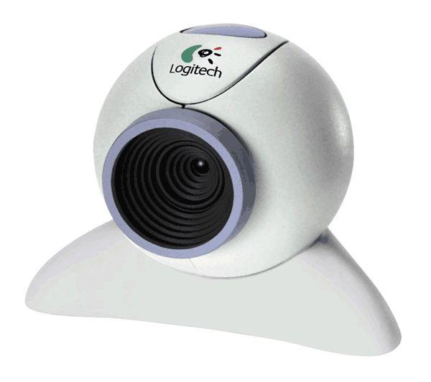
It no longer costs the earth to put together your own audio and video materials
New tools
New devices
New bandwidth
LOW-PRICE, HIGH QUALITY MEDIA CREATION

Slide 28

And we now have the bandwidth – even on mobile devices – to put that audio and video out there
3G
New tools
New devices
New bandwidth
WIDESPREAD BROADBAND AVAILABILITY

Slide 29
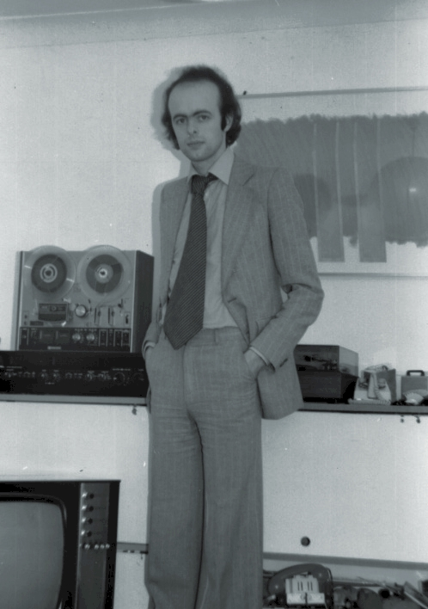
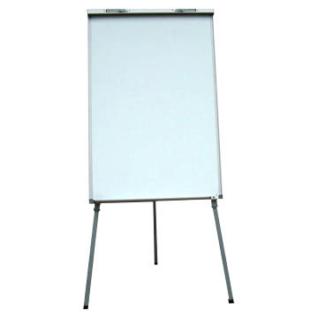
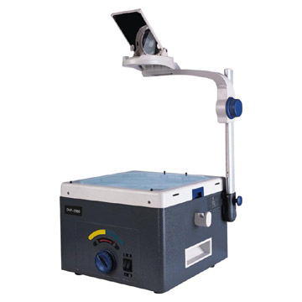
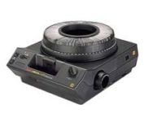
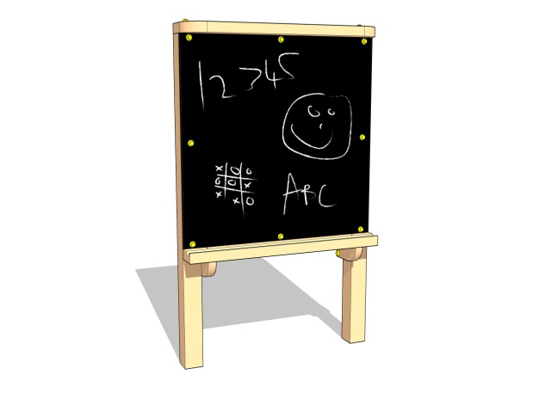
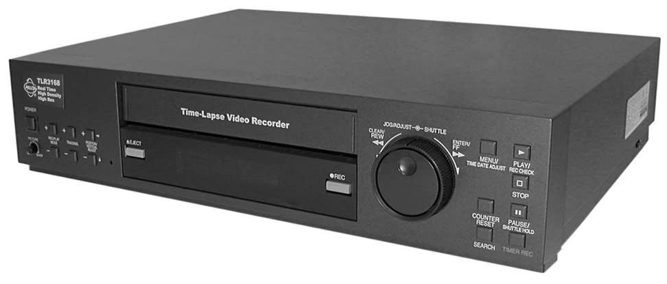
Thirty years ago, a new trainer would have been comfortable with all available media

Slide 30

But as new media have proliferated, many have backed away and left it all to the specialists

Slide 31
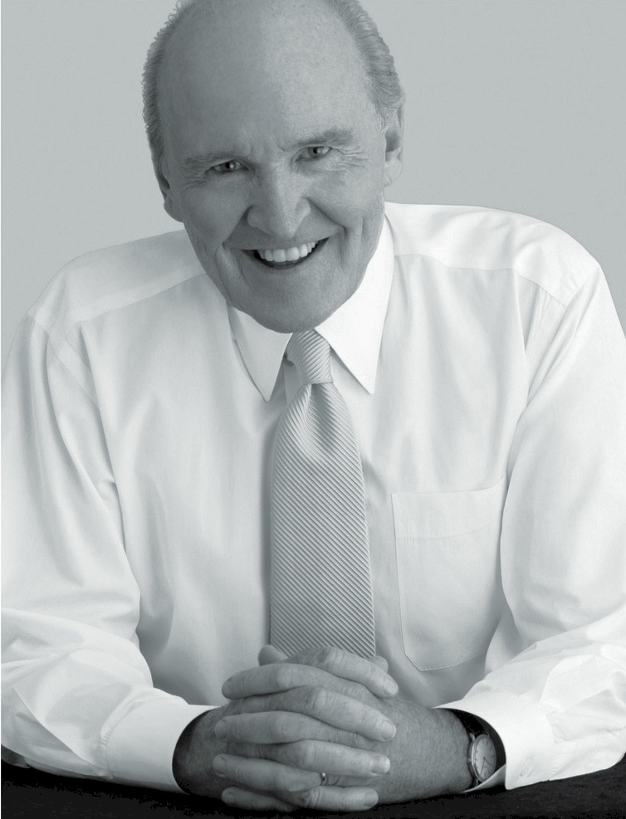
But as new media begin to affect all aspects of the work we do, it’s probably time to play catch up
“When the rate of change outside exceeds the rate of change inside, the end is in sight.”
Jack Welch

Slide 32

So what’s the gap? Here’s what one recent UK survey discovered …
Barriers to the successful implementation of new learning technologies:
A lack of knowledge about its potential use and implementation (>65%)
A lack of skills to implement and manage e-learning (>50%)
Towards Maturity benchmarking survey 2009

Slide 33
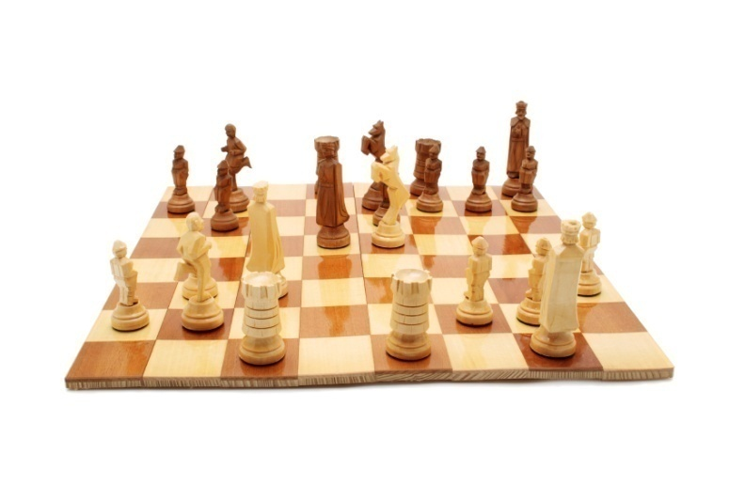
We need the skills to implement e-learning successfully as part of our overall l&d strategy
STRATEGIC SKILLS

Slide 34

We need to be able to integrate new media into next generation blended learning solutions
STRATEGIC SKILLS
CURRICULUM DESIGN

Slide 35
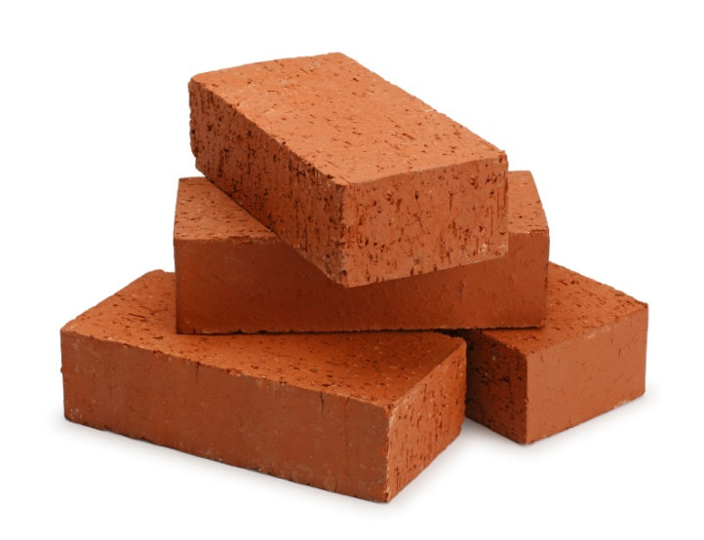
We need to be able to create e-content that is relevant, engaging and effective
STRATEGIC SKILLS
CONTENT CREATION
CURRICULUM DESIGN

Slide 36

And we need to adapt our facilitation skills to support online collaboration as well as face-to-face
STRATEGIC SKILLS
CONTENT CREATION
CURRICULUM DESIGN
FACILITATION

Slide 37
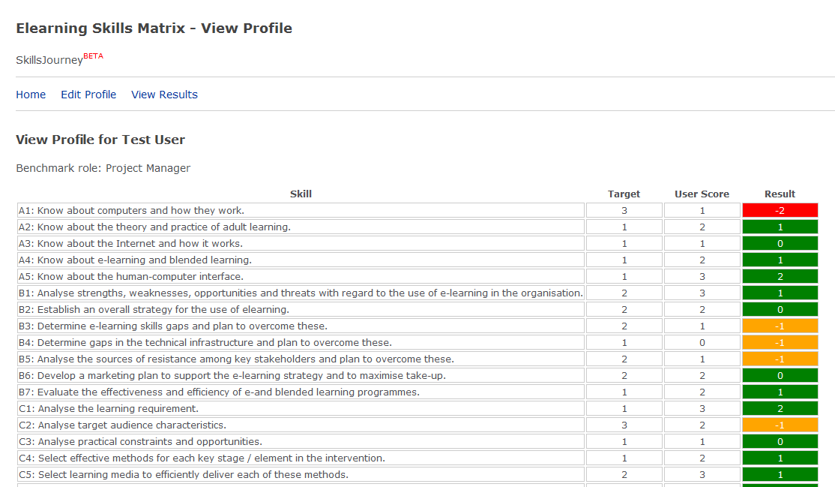
The new tool at skillsjourney.com will allow organisations and individuals to assess their e-learning skills gap
htttp://skillsjourney.com (beta)

Slide 38

It also points the way to available resources that will help you to bridge any gaps
Qualifications
Short courses
Networks
Resources

Slide 39


And when we’ve closed those gaps, we can look forward to a new era of l&d with confidence

Slide 40
The e-learning skills gap
www.skillsjourney.com
clive@skillsjourney.com

