Slide 1
The 5 (+1) Big Mistakes in Virtual Education
Versión en Español

Slide 2
Let’s begin by asking…

Slide 3
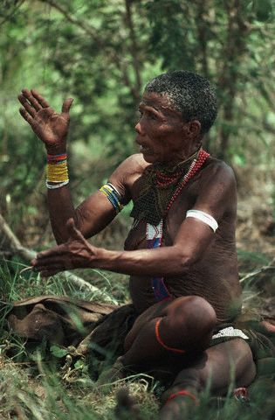
What is Education?

Slide 4
Education is just…

Slide 5
a story of stories.

Slide 6
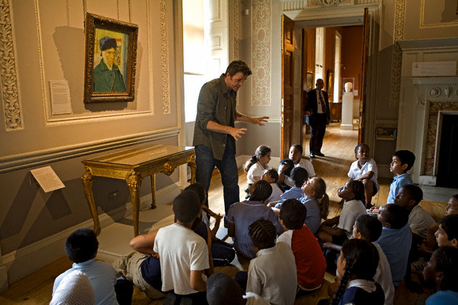
Someone wants to tell them

Slide 7
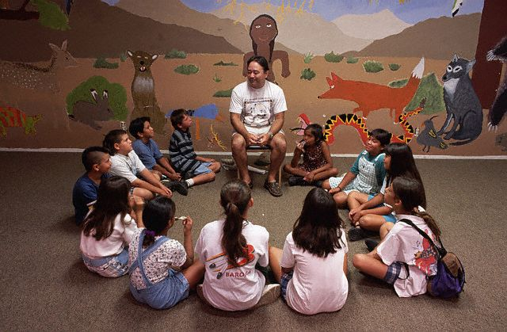
Someone wants to listen to them

Slide 8
Education happens

Slide 9
when you put together…

Slide 10
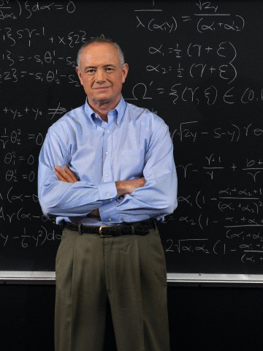
someone who wants to teach

Slide 11
+ someone who wants to learn

Slide 12
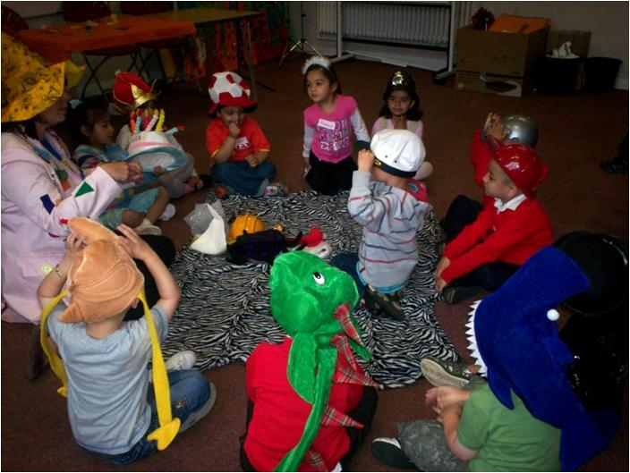

Slide 13
It is a simple equation.

Slide 14
You have the time and place of the teacher
abc
t1
TIME
p1
PLACE
Teacher

Slide 15
And
the time and place of the student
abc
t2
TIME
p2
PLACE
Student

Slide 16
abc
abc
t1
t2
p1
p2
Teacher
Student

Slide 17
Traditional Education
abc
abc
t1
=
t2
p1
=
p2
In traditional education both times and places are equal

Slide 18
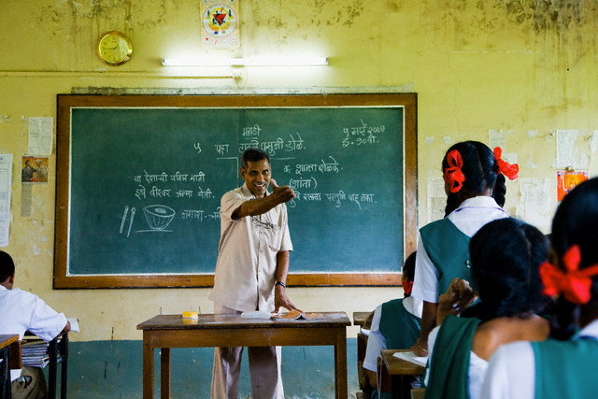

Slide 19
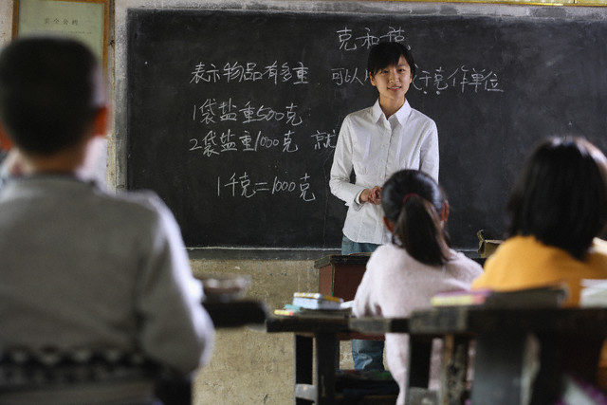

Slide 20
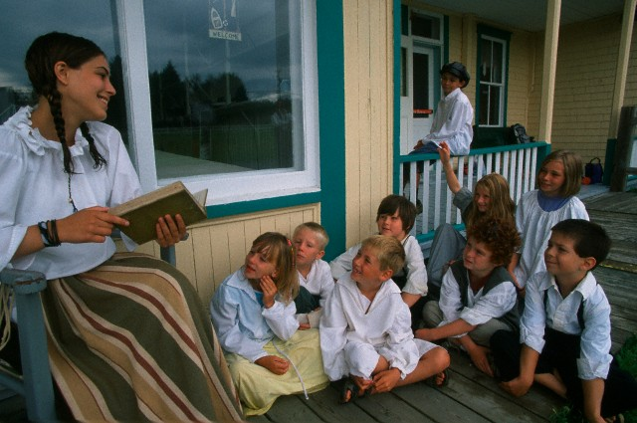

Slide 21
Virtual Education
WWW
abc
abc
t1
=
t2
p1
=
p2
In virtual education times
or places can be different

Slide 22
WWW
abc
abc
And the connection is…

Slide 23
WWW
Technology

Slide 24
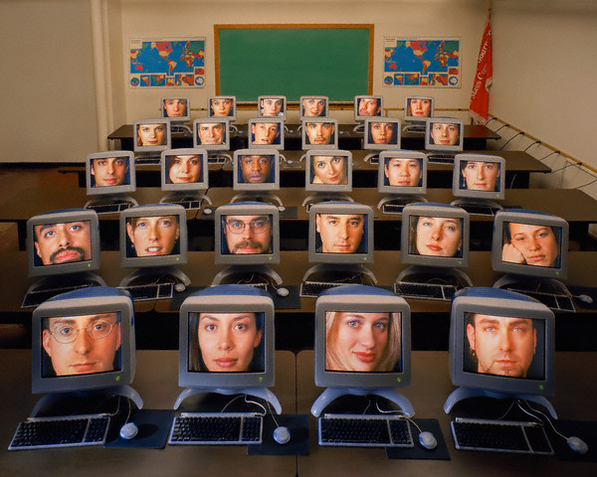

Slide 25
But virtual education

Slide 26
has been around for centuries.

Slide 28
Teachers and students

Slide 29
in different times and places

Slide 30
have been connected

Slide 31
by a technology called

Slide 32
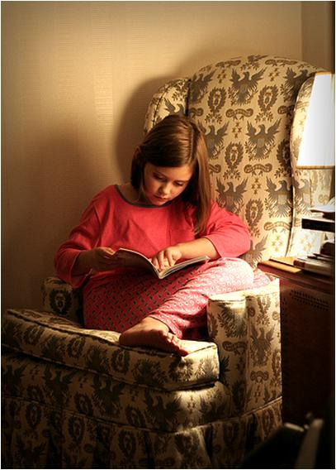
Books!

Slide 33
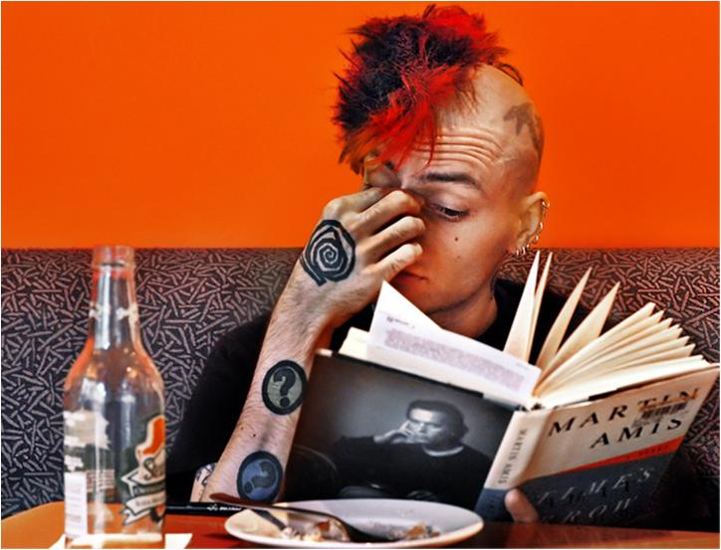
With this
ancient technology

Slide 34
someone in one time and place

Slide 35
can tell a story

Slide 36
to someone in a different time and place.

Slide 37
Hopefully…

Slide 38
Successful education

Slide 39
was based on «expert users»

Slide 40
of this ancient technology.

Slide 41
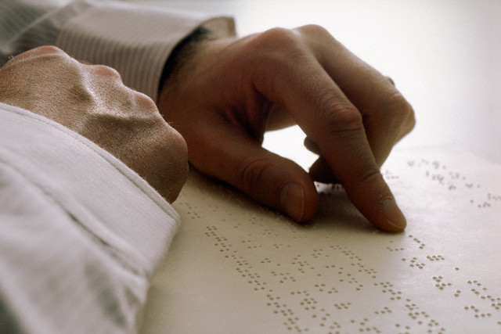
That is good readers and good writers

Slide 42
That is: good readers and good writers

Slide 43
Yesterday:

Slide 44
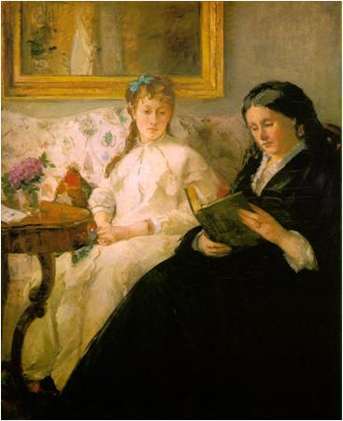
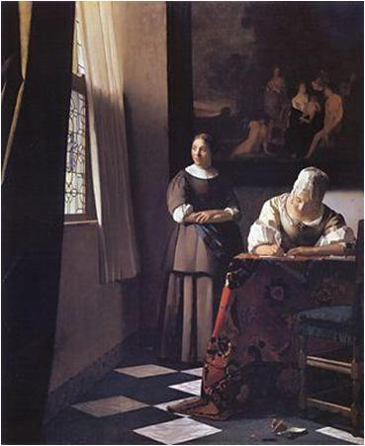
Reading
+
Writing
Berthe Morisot (1870)
Johannes Vermeer (1670)

Slide 45
Today:

Slide 46
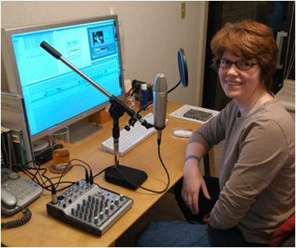
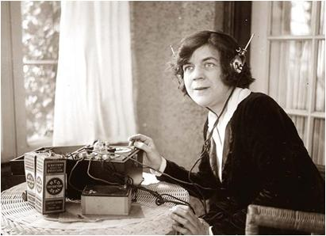
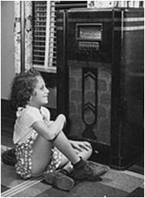
Recording
+
Playing
back

Slide 47
The process is the same

Slide 48
The tools are different

Slide 49
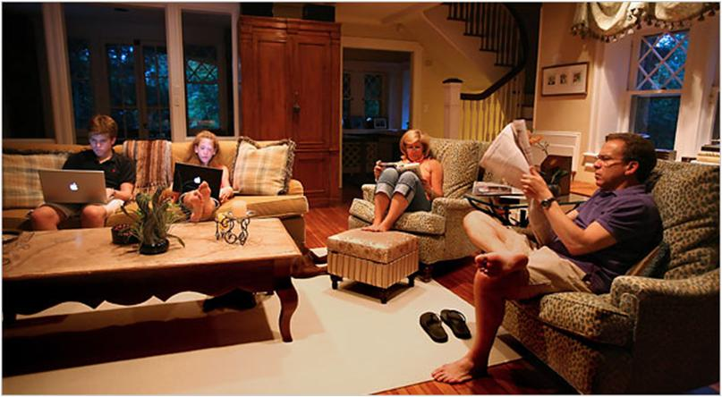
Different Media Different Speeds

Slide 50
When education has a time and a place

Slide 51
We have a course

Slide 52
A course is a place

Slide 53
where you can go

Slide 54
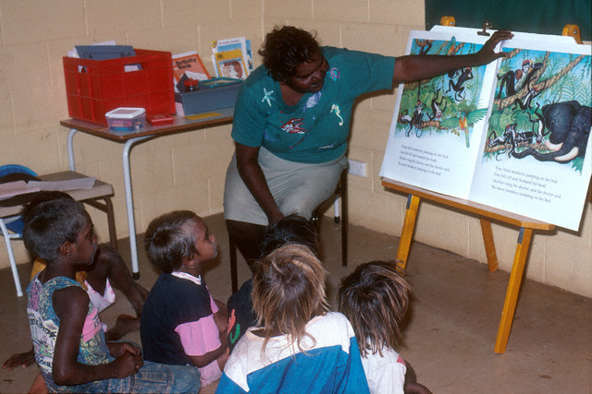

Slide 55
to listen to a story

Slide 56
Then a course is

Slide 57
One story

Slide 58
One story
+
One host

Slide 59
One story
+
One host
+
Several guests

Slide 60
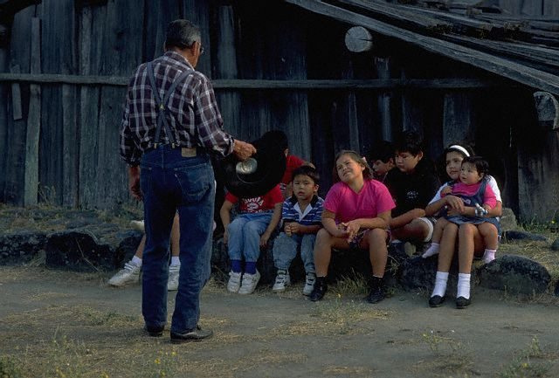

Slide 61
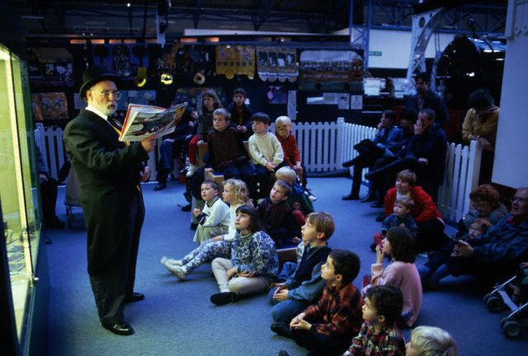

Slide 62
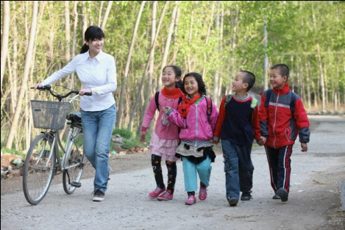

Slide 63
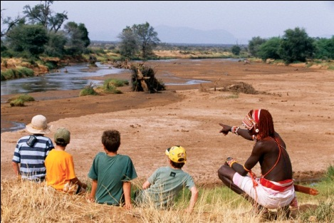

Slide 64
But today we have

Slide 65
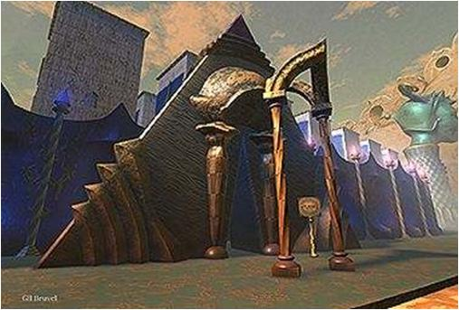
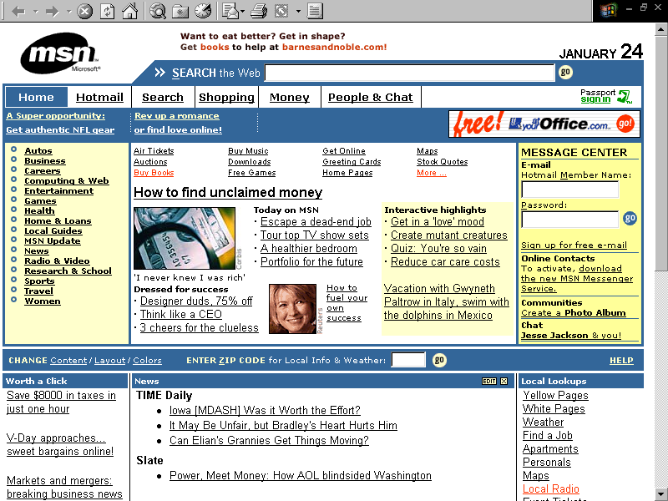
New principles
The Materials
Atoms vs. Bits
Processing Information vs. Moving Objects
Intangibles
Collective Knowledge
Generation of Ideas
Overinformation
Misinformation
Gil Bruvel

Slide 66
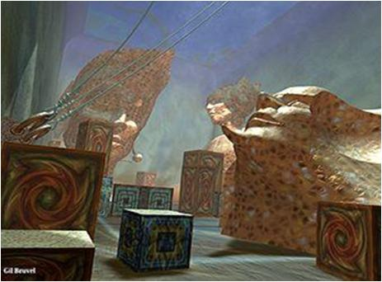
New principles
The Place
Distance is redefined
Frontiers are obsolete
The World is your audience and your competitor
Challenges and threats are closer…
one click apart
Gil Bruvel

Slide 67
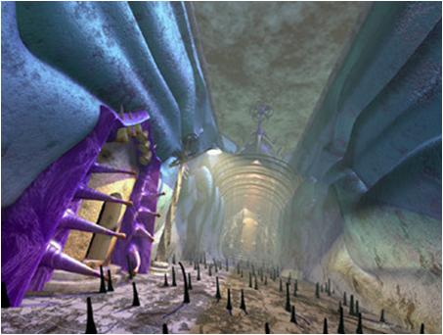
New principles
The Time
Instantaneous
Interactive / Feedback
Real time / Multitasking
Constant Change
A Life Project vs. A Life of Projects
Gil Bruvel

Slide 68
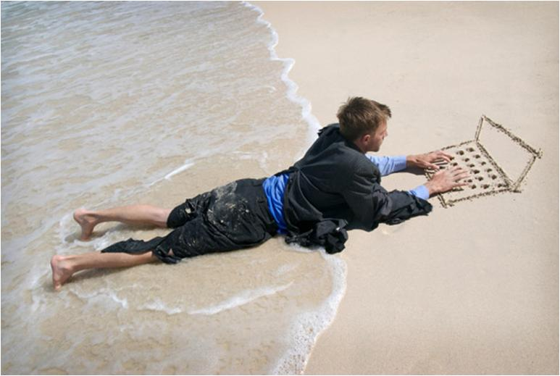
¡Help!

Slide 69
There is a new arena

Slide 70
for this ongoing conversation

Slide 71
between teachers and students.

Slide 73
The virtual classroom

Slide 74
WWW
Virtual Campus
Virtual Classroom
Activities
Discussions
Questionnaires
Homeworks
Glossaries
Chats
Blogs
Wikis
Resources
Links
Readings
Learning Objects
Files
Folders
Documents
Videos / Audios

Slide 75
A place full of tools

Slide 76
for the host to find new ways

Slide 77
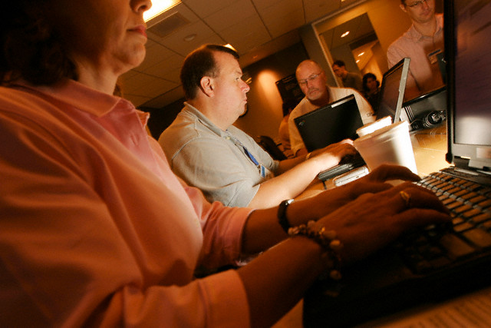

Slide 78
to tell the story

Slide 79
A story can be told in sequence
Virtual Classroom

Slide 80
Or not…
Virtual Classroom

Slide 81
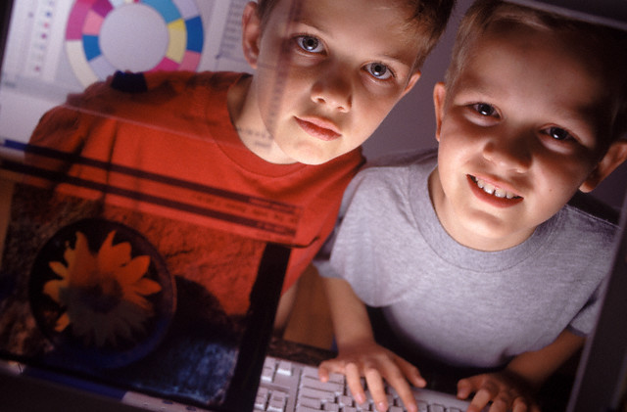

Slide 82
It can be full of resources
Readings
Audios
Links
Videos
Simulations
Learning objects

Slide 83
And activities
Glossaries
Wikis
Discussions
Blogs
Chats
Questionnaires
Homeworks
Puzzles

Slide 84
But it will be lifeless

Slide 85
without an active interaction

Slide 86
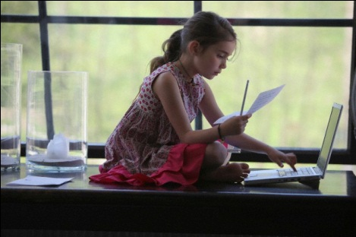
of all the participants

Slide 87
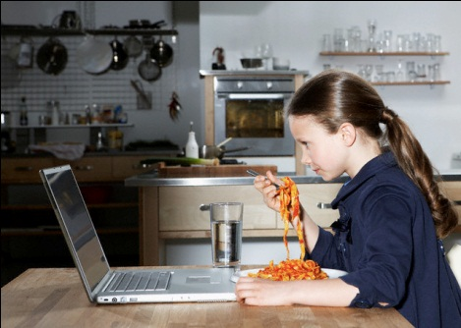

Slide 88
So the resources

Slide 89
and activities

Slide 90
are important

Slide 91
but not as important

Slide 92
as creating

Slide 93
A community

Slide 94
We can have

Slide 95
the best of both worlds

Slide 96
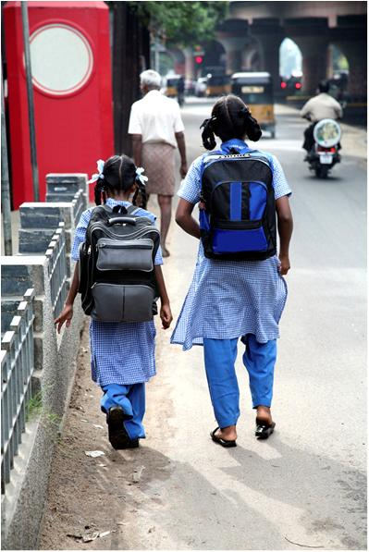
and go to school

Slide 97
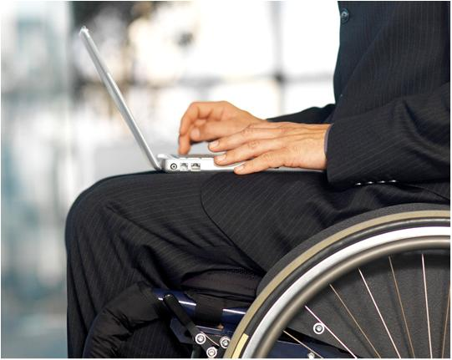
in many ways

Slide 98
But some schools are not getting it right yet…

Slide 99
and these are their 5 big mistakes…

Slide 100
Big Mistake #1
#1

Slide 101
Believing that Virtual Education = Massive Education
#1

Slide 102
#1
Technology is a multiplier
… but education is a one to one process.

Slide 103
#1
There is no limit in the number of
Participants
Materials
Activities
Links
…but learning is not accumulation but assimilation.

Slide 104
#1
You don’t have one course of 250
… you have 250 courses of one.

Slide 105
#1
You should be concerned when your desertion rate is 40%.
…That is. If you enrol 1000 students into an 8 semester program. Only 28 will be at the graduation ceremony.
…One out of 40 students.

Slide 106
Big Mistake #2
#2

Slide 107
Believing that Virtual Education = Mysterious and Complex Education
#2

Slide 108
#2
There is no mystery in connecting someone who wants to learn and someone who wants to teach.
…Give them the tools. They’ll do the magic.

Slide 109
#2
There is a myth that goes around: A good traditional teacher will not easily become a good virtual teacher.
...False. A good teacher is a good teacher with any tool.
…Unless you think that a «good» virtual teacher = a good actor.

Slide 110
#2
A halo of complexity and mystery is always convenient to create an elite group within the school for virtual education.
…We are transferring the vices and bureaucracy of old education to the new scenery.
…Welcome to the new and improved virtual inferno of politics and intrigue.

Slide 111
Big Mistake #3
#3

Slide 112
Putting Technology before Pedagogy
#3

Slide 113
#3
An educational system logic should be as follows:
Student ◄ Teacher ◄ Materials ◄ Technology
…Technology is the tool that helps the teacher create materials to share with the student
…Technology should be the bridge that allows the teacher – student interaction.

Slide 114
#3
But the real system usually works like this:
Student ◄ Materials ◄ Technology ◄ Teacher
…Teachers become subordinates of technology which dictates the way they should tell the story.
…See how far the teacher is. Probably that is why they call it “distance” education.

Slide 115
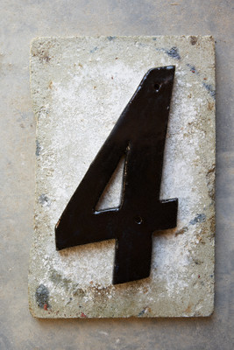
Big Mistake #4
#4

Slide 116
Underestimating your Teachers and Students
#4

Slide 117
#4
Some schools have developed a virtual education system, but it is a closed system.
…Closed to criticism, closed to experimentation, closed to innovation

Slide 118
#4
Standardization and modularity are the dogma.
…Teachers cannot move freely outside predetermined paths.
…Neither do students.

Slide 119
#4
Students receive predesigned “objects”, “packages”, “modules”. Not courses.
…A package is the product of a designer. A course is an unpredictable and single event hosted by an educator.
…A module is predetermined, a course is contingent.
Like the course of a river.

Slide 120
Big Mistake #5
#5

Slide 121
Taking the Fun out of Education
#5

Slide 122
#5
In some schools, virtual education and stress are synonyms.
…Control, supervision, measurements, indicators and reports have replaced the freedom and flexibility that was originally promised in virtual education.
…Education was transformed into an industrial process.

Slide 123
#5
Education should be accidental, unpredictable, unscripted.
…There is plenty of room in virtual education for spontaneity.
…Students and teacher should be encouraged to take risks.

Slide 124
#5
All courses cannot be structured the same way.
…Uniformity and homogeneity can not be part of a human process.
…Doing, thinking, watching, analizing, proposing, building: the same ingredients cannot be equally formulated for all courses.
…Some courses are intensive in communication, some in reading, some in autoevaluation, some in theory, some in practice.
…The only constant for all courses is the genuine desire of both teachers and students to interact and have fun.

Slide 125
#5
Some schools are searching for the “formula” for virtual education. For the mould of the perfect course.
…”Virtualizing” a subject of study should not kill its charm.
…The labor of a virtual teacher should be amusing and fascinating.
Although we have to disobey our institutions to make it so.

Slide 126
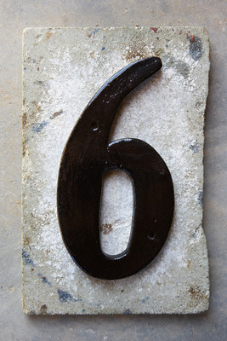
+ 1 More Big Mistake
+1

Slide 127
Making the same mistakes…
+1

Slide 128
and expecting different results.
+1

Slide 129
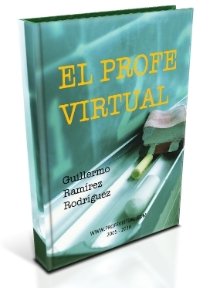
Thank you
Find my free e-book
“El Profe Virtual” (Spanish)
http://www.profevirtual.com
Guillermo Ramírez
Oct. 2010
(Do not hesitate to vote for this presentation if you like it)

